Slide 1
Resolution of Vectors
10 PRE-ATAR SCIENCE

Slide 2
Review
Last lesson we:
defined force
types and effects of forces
contact and non-contact forces
newtons (N)

Slide 3
Review Questions
1. Classify these as contact or non-contact forces:
A) friction
B) magnetism
C) gravitational
D) Tension
E) Pressure

Slide 4
Review Questions
2. Convert the following:
A) 10 kg to N
B) 10 N to kg
C) Using F = m x a
  determine the force if a mass of 650 kg accelerates at 2ms⁻²

Slide 5
Learning Intentions
The motion of objects can be described and predicted using the laws of physics

Slide 6
Success Criteria
Describe force as a vector quantity
Determine resultant vectors for forces in straight lines and at right angles, either mathematically or by using scaled diagrams

Slide 7
Key words
vector
magnitude
resultant force
resolution of vectors

Slide 8
Forces as vectors
Vector quantities have both magnitude (size) and direction. Forces can be represented by arrows, with the length of the arrows tail showing the size of the force.

Slide 9
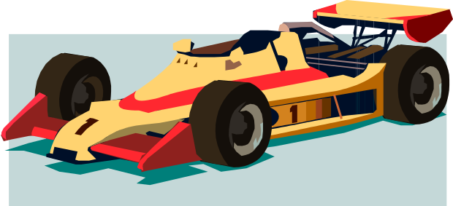
Resultant Force
Often, an object is acted upon by more than one force.
Consider this car:
n
p
f
g

Slide 10
If the forces acting on an object are unbalanced, then the object may speed up, slow down or change direction as if it were being acted upon by a single force.
If all the forces “cancel out” or balance, then the net force ∑ is 0. The motion of the object will not change.

Slide 11
Adding vectors
15N
10N
∑= 25N

Slide 12
15N
5N
∑= 10N

Slide 13
Vectors at other angles
Draw them to scale and measure, or do some trigonometry on them (Pythagorus at 90º)

Slide 14
Play this
http://phet.colorado.edu/en/simulation/vector-addition

